Slide 1
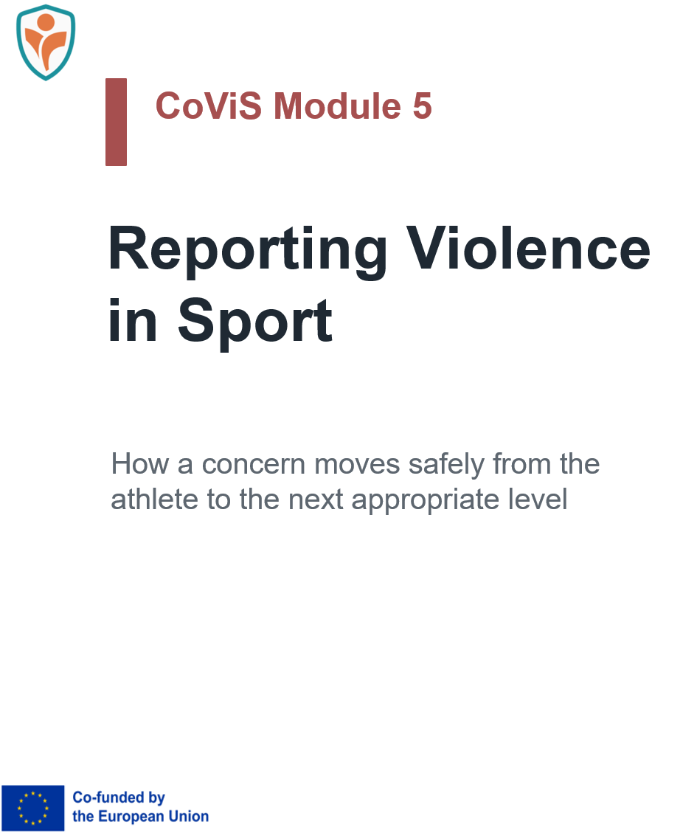


Slide 2


Why reporting matters
CoViS insight: In the CoViS sample, reporting and disclosure were split almost exactly in half.
50%
reported or disclosed
a concern
50%
did not report or disclose
What this tells us
A reporting module is essential because many athletes still do not move concerns forward, while those who do often start informally rather than through official channels.
74.7%
Among those who reported, the most common first person told was a teammate.
16.5%
Some athletes first told a parent or another family member.
5.1% coach | 3.8% official
Formal routes were much less common as a first step.
Source: CoViS Needs Analysis reporting findings.

Slide 3
Reporting is not the same as proving
Disclosure
Telling a trusted person what happened or what is worrying the athlete.
Report
Passing the concern to a person or body with responsibility to respond, record, refer or escalate.
Escalation
Moving the concern to a safer or higher level when the first route is not enough.
Investigation
A formal process handled by the appropriate authority.
Key message: The athlete’s job is to speak up, not to prove the case.
The trusted person’s job is to listen and help, not to investigate.
Why this matters
Many athletes stay silent because they think they must be certain, have evidence, or know exactly what will happen next.

Slide 4
For the athlete
The CoViS practical reporting ladder
These steps are for the athlete in settings where formal safeguarding structures may be weak, unclear or inconsistent.
1. Safety first
If there is immediate danger, prioritise safety.
2. Tell a safe person
A teammate, parent, family member or another trusted adult may be the first step.
3. Do not carry it alone
You do not have to manage the concern by yourself.
4. Move it up
Help the concern reach a responsible person or body.
5. Follow up
Clarify who now has responsibility and what happens next.

Slide 5
For the athlete
What information is useful?
A first report can be simple
The athlete does not need to produce a detailed formal statement alone. A simple, factual first report is enough to begin.
› what happened
› who was involved
› when and where it happened
› whether anyone else saw or heard it
› whether messages, screenshots or notes exist
› whether there is an immediate safety concern
Important limit
The athlete does not need to confront the person, search for evidence, persuade witnesses or prove the case before speaking up.
If the usual route feels unsafe
If the person with power is also the usual reporting contact, the concern should not be routed back through that same person. Another trusted adult, another official, a higher governing body or an external/public route may be needed.

Slide 6

If an athlete tells you
What not to say
› “Are you sure?”
› “Why didn’t you say it earlier?”
› “Maybe it was only a joke.”
› “Don’t tell anyone.”
› “This could damage the team.”
Basic first response
› listen calmly
› thank the athlete for telling you
› focus on immediate safety
› do not investigate the case yourself
› do not promise absolute secrecy
› help the concern reach the next appropriate level
Keep the role clear
The trusted person helps the concern move forward. Detailed trauma-informed case management belongs to the later stage of dealing with the case, not to the athlete’s first disclosure.

Slide 7
What happens after the report?
Athlete-centred expectation
After a concern is reported, the athlete should be informed and supported rather than left in silence.
1. Receive
A responsible person or body receives the concern.
2. Protect
Immediate safety and basic support are considered.
3. Clarify
Basic information may be gathered to decide the next step.
4. Refer / escalate
The case is moved to the appropriate level.
5. Inform
The athlete should know what happens next.
Important reminder
The focus is on how to report the concern gets there. Full case management and support are addressed in the CoViS Module 4.

Slide 8

Why reporting pathways matter
Lesson from the Nassar case
Disclosure to adults and institutions is not enough if concerns are not escalated, acted on with urgency, and connected to protective action.
Failure 1
Athletes and families raised concerns, but the system did not consistently convert disclosure into effective action.
Failure 2
The FBI watchdog later found serious mishandling of allegations, including delays, non-compliance and failures in responding to ongoing child sexual abuse.
Failure 3
Institutions were too slow to grasp the scale of harm and failed to treat survivors with the care and respect they deserved.
Practical lesson: safe sport needs clear routes,
backup routes and reliable escalation beyond the first adult who hears the concern.
Sources: U.S. DOJ OIG audit follow-up on FBI handling of hands-on sex offense tips (2024); Michigan State University Nassar-related information.

Slide 9
Barriers and enablers
Why people do not report - and what helps
Common barriers
› fear of not being believed
› fear of retaliation, exclusion or gossip
› uncertainty whether the behaviour is “serious enough”
› loyalty to the team or dependence on powerful people
› lack of a clear reporting route
What helps
› clear information about who to tell
› more than one reporting route
› trusted teammates and adults
› basic confidentiality
› follow-up after disclosure
› clear possibility to go to a higher level
Bottom line: Better reporting is not only about athlete courage; it is also about safer systems.

Slide 10
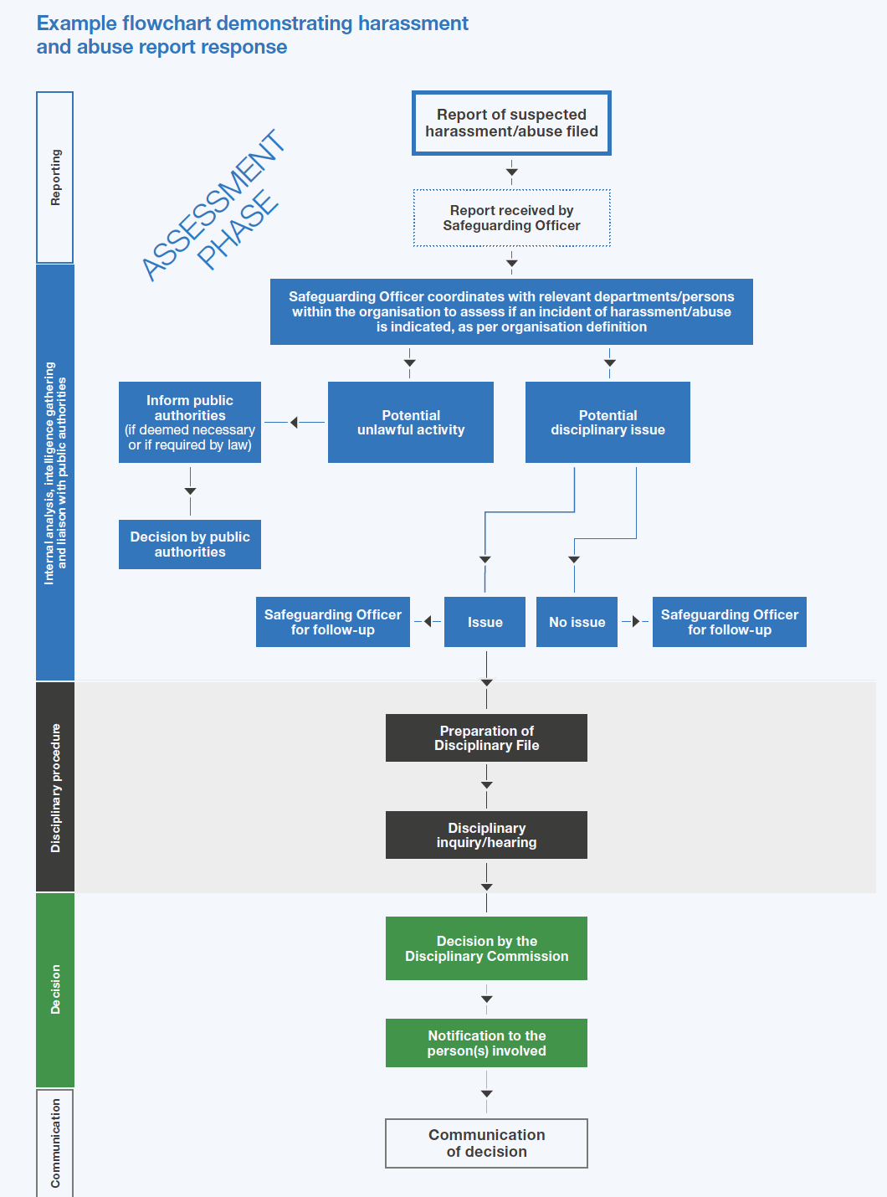
For sport organisations
What sport organizations should build
Minimum features
› a trained safeguarding person or officer
› clear and visible reporting routes
› more than one contact point
› basic confidentiality
› written procedures
› ability to escalate beyond the club
CoViS recommendation
Clubs and federations should move from informal practice to named, trained and accessible reporting structures.
Final message: A concern should never depend on one person only. Safe reporting requires routes, backup routes and a system that actually responds.

Slide 11
Funded by the European Union. Views and opinions expressed are however those of the author(s) only and do not necessarily reflect those of the European Union or the European Education and Culture Executive Agency (EACEA). Neither the European Union nor EACEA can be held responsible for them.

