Slide 1

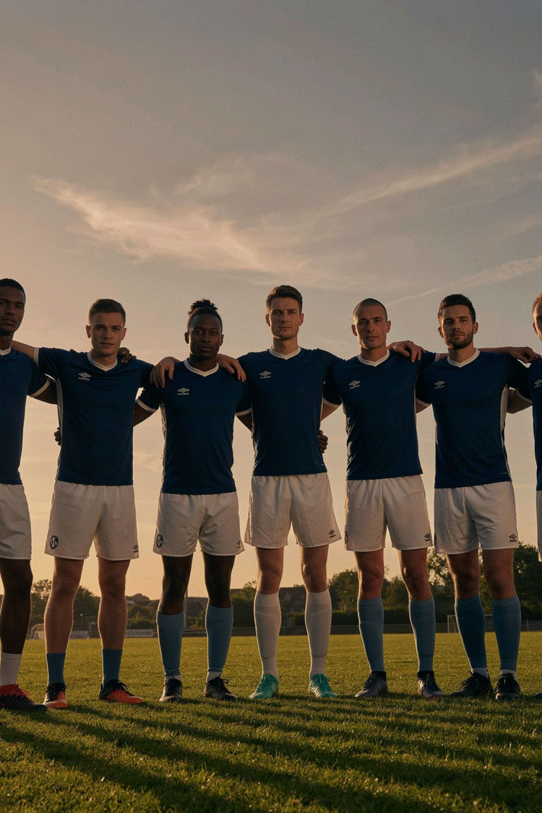

CoViS Module 4
Coping with Violence
in Sport
Safety, support, recovery and restoring control after violence
Notes:
Open with the simple message: this module is about recognising concern early, not proving guilt.

Slide 2

Coping with Violence
How to respond, seek support and recover after an incident
This module explores what happens after an experience of violence and how athletes, teammates, coaches and sport organisations can respond appropriately.
Safety
Support
Trust
Recovery
Access to Help
Key focus: Safety • Support • Trust • Recovery • Access to Help

Slide 3
What Happens After an Incident?
People can react to violence in very different ways.
An athlete may experience:
Fear
Anger
Shame or embarrassment
Confusion
Guilt
Loss of trust
Reduced motivation
Feeling unsafe in the sporting environment
There is no single "correct" reaction.
Different reactions do not determine how serious an experience was.

Slide 4

Immediate Response: What Comes First?
After an incident, the priority is safety and support. Five key steps:
01
02
03
Ensure safety
Preserve relevant information
Seek support
Move away from an unsafe situation when possible.
Keep messages, screenshots or basic information about the incident when appropriate and safe.
Talk to someone you trust.
04
05
Consider reporting options
Follow up
Understand what reporting pathways are available.
Support may be needed beyond the first conversation.
Remember: Safety comes first.

Slide 5
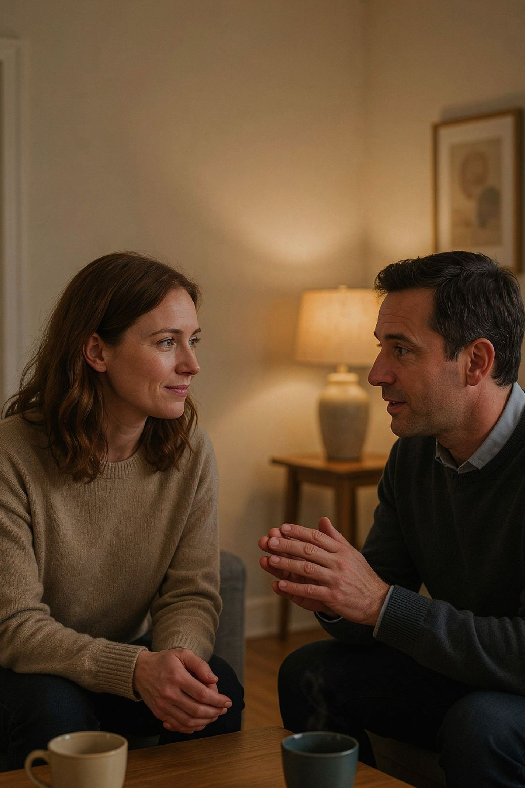

How to Support an Athlete
When an athlete tells you about violence:
DO:
DON'T:
✓ Listen
✓ Take the concern seriously
✓ Stay calm
✓ Respect the person's needs
✓ Ask how you can help
✓ Help them access appropriate support
✗ Blame
✗ Judge
✗ Minimise the experience
✗ Pressure them to tell you everything
✗ Promise outcomes you cannot guarantee
✗ Try to investigate the situation yourself
Your first role is to support - not to investigate.

Slide 6
Trusted Persons & Support Networks
Who can an athlete talk to?
Inside sport:
Outside sport:
Trusted teammate
Coach or trusted staff member
Safeguarding/Welfare Officer
Club or federation representative
Medical or psychological staff
Family member
Trusted friend or adult
Psychologist or counsellor
Healthcare professional
Specialised support service
Think about:
Who are the people I would feel safe talking to?
Having more than one option is important.

Slide 7
Recovery Is a Process
Recovery is different for every person.
There is: NO fixed timeline. NO single correct way to recover.
Support should help the athlete regain:
SAFETY
CONTROL
"I feel protected."
"My voice and choices matter."
TRUST
CONFIDENCE
"I know there are people who will support me."
"I can participate without feeling blamed or judged."
Do not pressure someone to "move on".

Slide 8
Returning to Sport
Returning to training or competition may be an important part of recovery - but it should happen in a way that supports the athlete's safety and well-being.
Where appropriate, support may include:
Adjustments to training arrangements
Additional supervision
Access to a trusted person
Clear communication
Continued follow-up
Professional support when needed
Key principle: An athlete should not have to choose between receiving support and continuing the sport they value.

Slide 9





Where Can an Athlete Find Support?
Support may come from:
SPORT ORGANISATION
Safeguarding/Welfare Officer · Designated contact person · Trusted staff member · Club/Federation · Medical or psychological staff
EXTERNAL SUPPORT
Counselling/Psychological services · Healthcare professionals · Specialised support organisations · Child protection services, where applicable · Relevant public authorities
CoViS PLATFORM
Support information · Country-specific contacts · Reporting guidance · Available support pathways
If the first person does not help, seek another appropriate source of support.

Slide 10
Remember the 5 Principles
01
02
03
SAFETY
LISTEN
SUPPORT
Protect the person from further harm.
Listen without judgement.
Help the person access appropriate assistance.
04
05
CHOICE & CONTROL
FOLLOW-UP
Involve the person in decisions whenever possible.
Support should continue when needed.

Slide 11
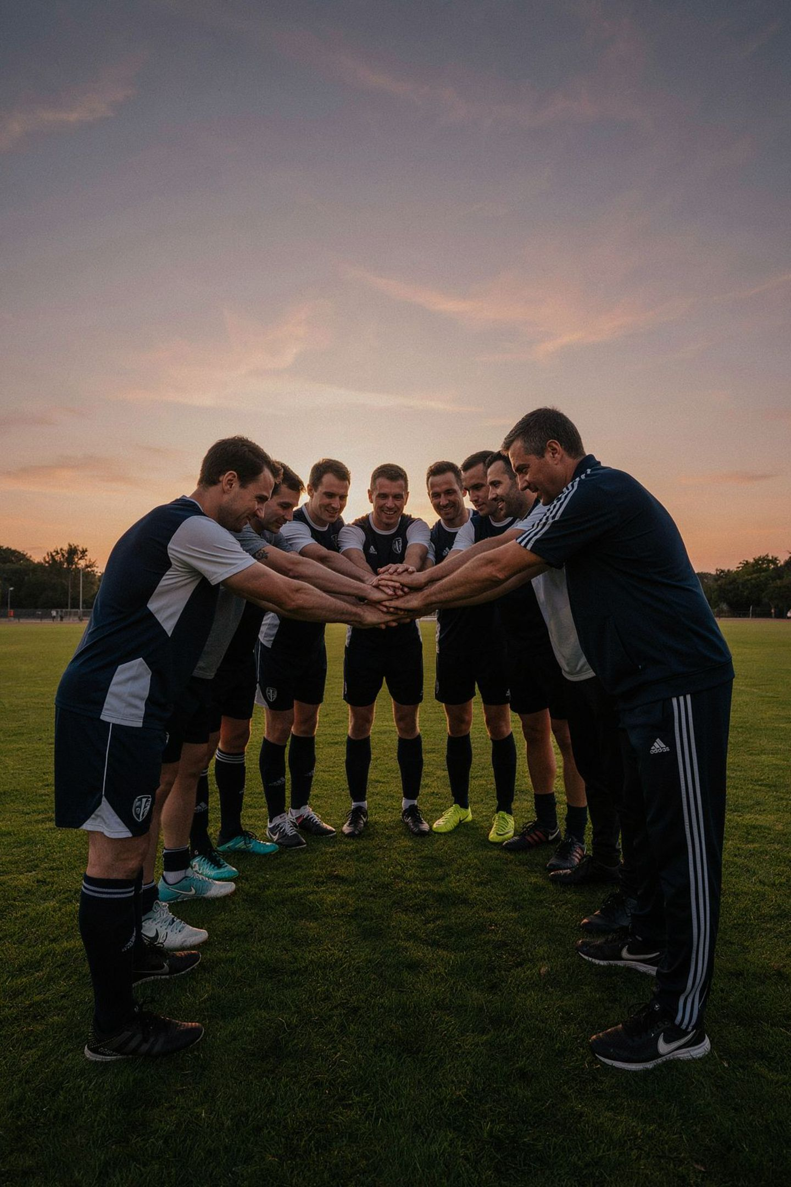
For effective coping with violence in sport
You do not have to deal with violence alone.
Listen. Take concerns seriously. Seek support.
Together, athletes, coaches, teammates and sport organisations can create safer and more supportive sporting environments.

Slide 12
Funded by the European Union. Views and opinions expressed are however those of the author(s) only and do not necessarily reflect those of the European Union or the European Education and Culture Executive Agency (EACEA). Neither the European Union nor EACEA can be held responsible for them.

