Slide 1

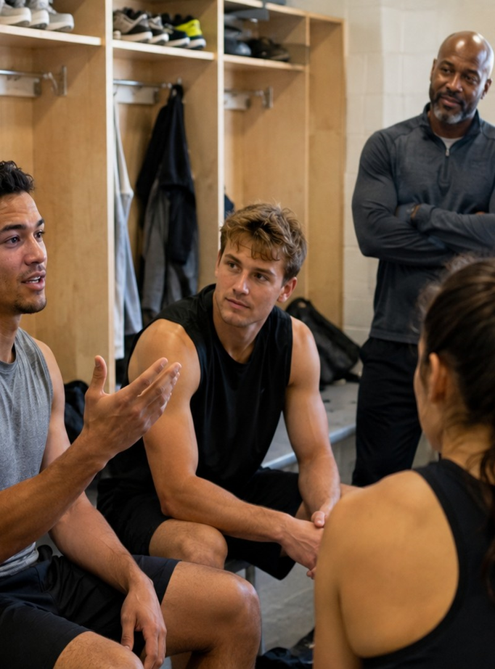

CoViS Module 3
Bystander Action in Sport
Responding safely when you witness inappropriate behaviour
Notes:
Open with the simple message: this module is about recognising concern early, not proving guilt.

Slide 2

A practical prevention pathway
Bystander action is a sequence of decisions—not a single heroic act.
NOTICE
INTERPRET
OVERCOME BARRIERS
CHOOSE A RESPONSE
SUPPORT
REINFORCE CULTURE
What is happening?
Why does it matter?
What stops action?
Which option is safest?
Who needs care?
What norm do we build?
The best action is safe, proportionate and likely to reduce harm.
Notes:
Explain that trainees do not need to memorise one perfect answer. The pathway helps them pause, assess safety, and choose an action that fits the situation.

Slide 3
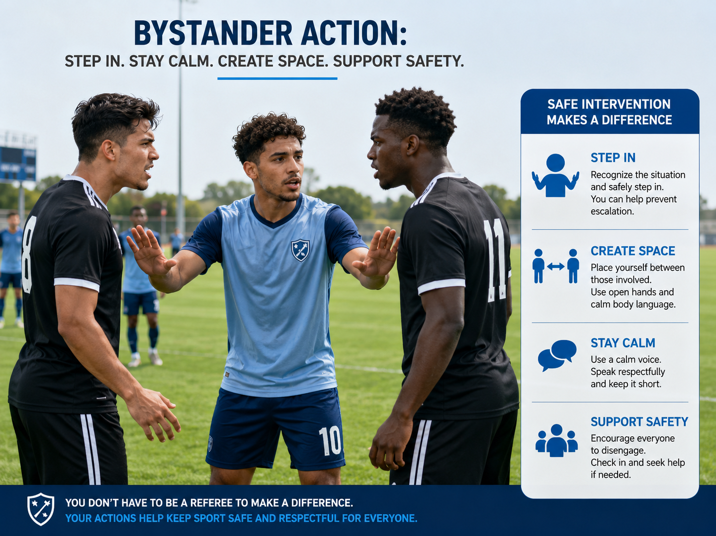
Why bystanders matter
Reactions from teammates and staff influence what becomes normal.
• Bystanders can be athletes, coaches, ASP, volunteers or other sport personnel
• Silence can make sexist, degrading or boundary-crossing behaviour seem acceptable
• Small actions can reinforce respect, equality and safety
• Bystander action matters before serious incidents occur
Silence and action both shape team culture.
Notes:
Use examples from sport: sexualised jokes, gender stereotypes in coaching feedback, humiliating banter. Emphasise that bystanders help set the tone of the environment.

Slide 4
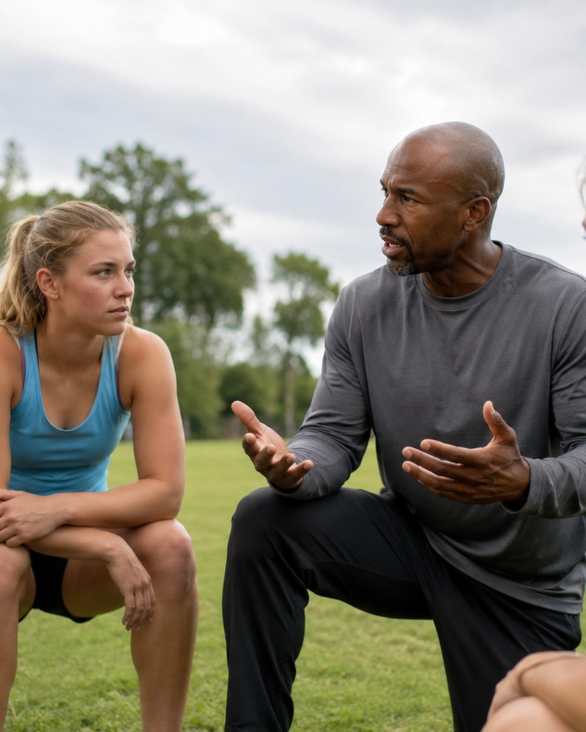
Recognising when action may be needed
Early recognition creates more options for safe intervention.
Language
Pressure & boundaries
Sexist jokes, sexualised comments, gender-based insults, degrading “banter”.
Sexual pressure, intrusive questions, unnecessary physical contact, persistent messaging.
Peer culture
Power imbalance
Humiliating initiation practices, body shaming, homophobic or transphobic teasing.
Situations where the person affected may feel unable to object or refuse.
Ask: Is someone being disrespected, pressured, humiliated or sexualised?
Notes:
Ask participants to think about ambiguous situations, not just obvious serious incidents. The goal is to notice patterns that may undermine dignity, equality or safety.

Slide 5
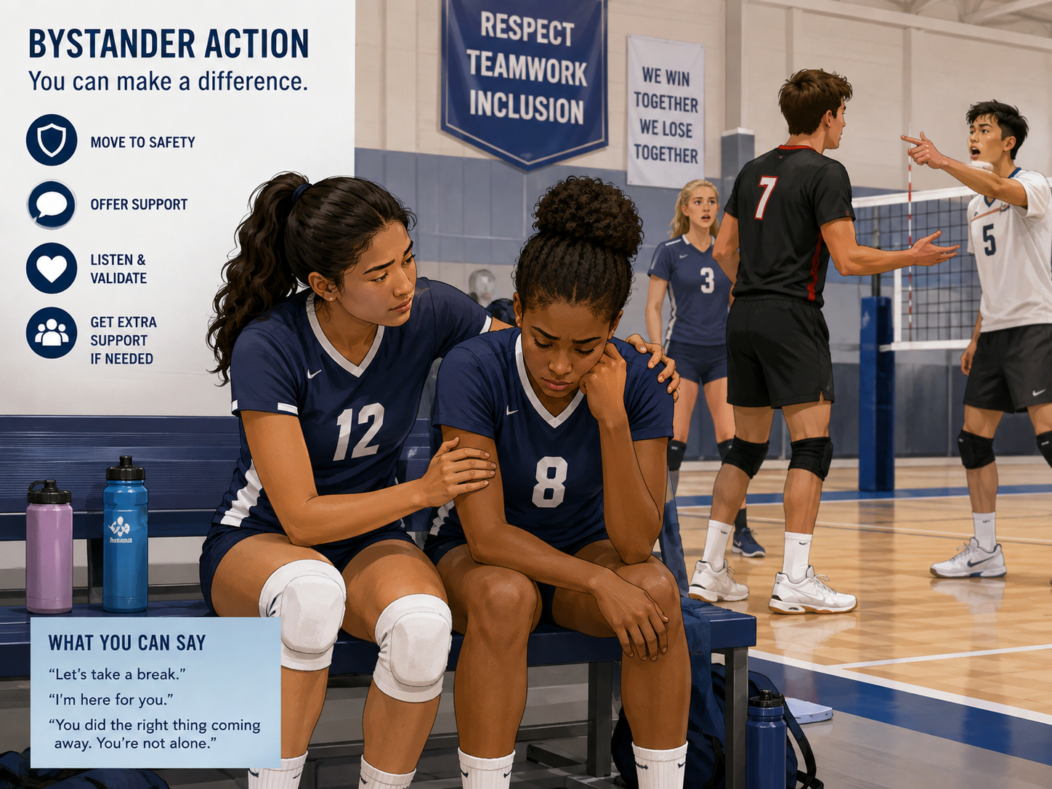
Why intervene?
Bystander action helps prevent harm from becoming a pattern.
• It communicates that harmful behaviour does not fit team values
• It can stop behaviour from continuing or escalating
• It shows support to the person affected
• It strengthens trust and shared responsibility within the team
Doing something safe and proportionate can make a difference.
Notes:
Make clear that intervention does not always mean confrontation. Even small responses can shift norms and make people feel less alone.

Slide 6

Why people sometimes do not intervene
Hesitation is common—preparation makes action easier.
Uncertainty
Diffusion
“Maybe I misunderstood.”
“Everyone else seems fine with it.”
Social cost
Power & safety
“I might damage team relationships.”
“What if this affects my place or opportunities?”
Name the barrier → choose a safer way to act.
Notes:
Discuss barriers without blaming participants. Ask which barrier would be most likely to stop them and which support would make action easier.

Slide 7
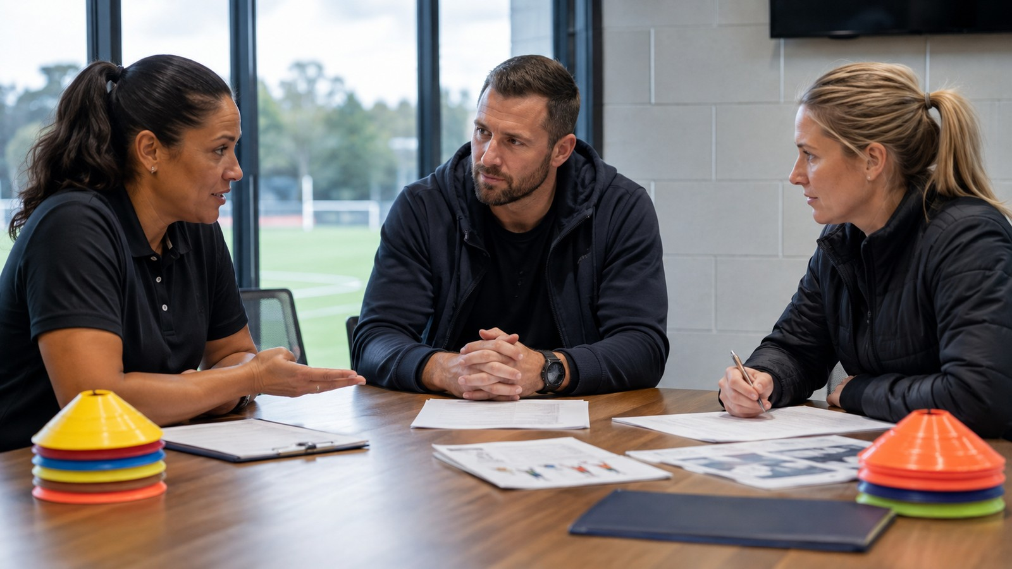
Choosing a safe response
Intervention does not always mean direct confrontation.
DIRECT
DISTRACT
Calmly name the behaviour
Interrupt or change the situation
SEEK SUPPORT
DELAYED
Involve someone better placed to act
Follow up later when safer
Choose the response most likely to reduce harm safely.
Notes:
Present the four strategies and explain that different situations require different choices. The best option is not necessarily the most confrontational one.

Slide 8
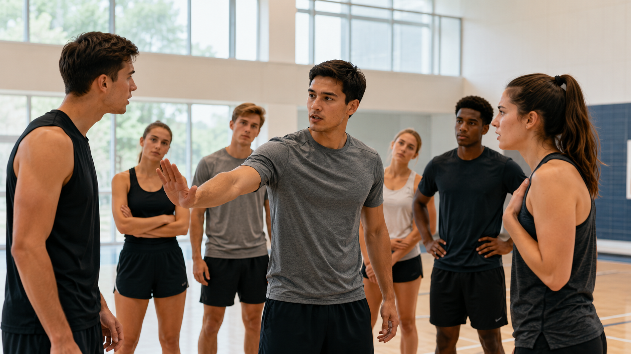
The four response options
Practical phrases and actions trainees can use.
Direct
Distract
Seek support
Delayed
“That comment is not appropriate.”
“Let’s not talk about teammates like that.”
Change the topic; ask someone to help; move the group to another activity.
Approach a captain, coach, team manager, ASP or safeguarding officer.
Check in later: “I noticed what happened. Are you okay?”
Which strategy would be safest in a situation involving a senior athlete or coach?
Notes:
Invite trainees to develop their own words. Encourage short, calm and realistic phrases that fit their context.

Slide 9

Challenging “banter” and harmful gender norms
Everyday language is a realistic opportunity for prevention.
• Sexist jokes and sexualised comments can make disrespect seem normal
• Harmful language may be dismissed as “just banter”
• Short, calm questions can interrupt the norm without escalating
• Inclusive language models respect, equality and dignity
Try phrases like:
“What do you mean by that?”
“We don’t need to use gender as an insult.”
“Let’s keep the feedback about performance.”
Notes:
Define banter as informal joking or teasing. Explain that the issue is when it becomes sexualised, humiliating, discriminatory or normalises stereotypes.

Slide 10
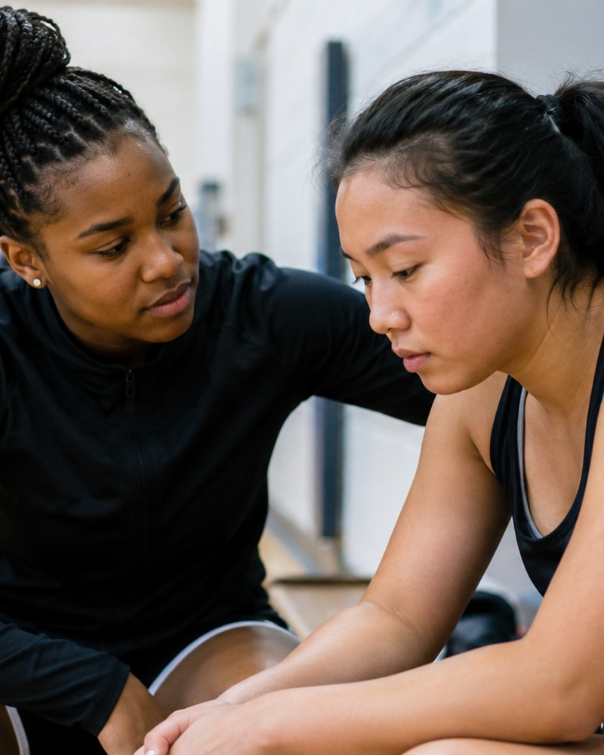
Supporting the person affected
Bystander action can also mean care, validation and restoring autonomy.
Check in privately
Listen without blame
“I noticed what happened earlier. Are you okay?”
Avoid judging, investigating or demanding details.
Respect choices
Restore safety
Ask what would be helpful. Do not pressure them into one course of action.
Help them leave an uncomfortable space or identify appropriate support.
Bystander’s role is not to investigate. Their role is to support.
Notes:
Emphasise that supportive responses should be centred on the person affected. The aim is to listen, validate and respect autonomy, while recognising safeguarding responsibilities where relevant.

Slide 11
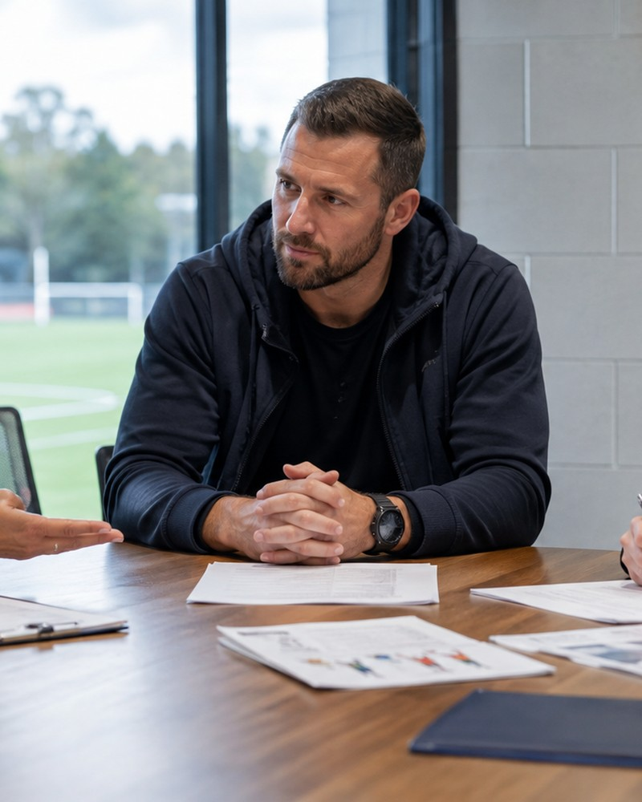
Power, safety and collective responsibility
When authority is involved, indirect action can be the safer choice.
• Ask: who holds power in this situation?
• Is direct intervention safe for everyone involved?
• Who else could influence the situation?
• What action reduces harm without increasing risk?
Effective action is not measured by how confrontational it is.
Notes:
Discuss power in sport: selection, playing time, treatment, reputation, career opportunities. Safer action may involve a captain, another coach, a safeguarding officer or trusted person.

Slide 12
Creating a team culture where people act
Individual skills are easier to use when teams support intervention.
• Respectful intervention is valued, not treated as disloyal
• Leaders model the standards they expect from others
• The team rejects sexism, sexualisation and humiliating “traditions”
• Speaking up respectfully is treated as commitment to the team
Team standard examples
“We challenge disrespect without humiliating people.”
“Supporting teammates is valued.”
Notes:
Explain that teams need explicit expectations so people do not assume they are alone in objecting to harmful behaviour. Make positive team norms visible.

Slide 13

Bystander support starts before harm occurs.
Build respect. Protect autonomy. Strengthen boundaries. Support action.
Final reflection
What is one behaviour you will challenge, one way you will support a teammate, and one team norm you will reinforce?
Notes:
End with personal commitment. Invite participants to write down one concrete action they can use in their sport environment.

Slide 14
Funded by the European Union. Views and opinions expressed are however those of the author(s) only and do not necessarily reflect those of the European Union or the European Education and Culture Executive Agency (EACEA). Neither the European Union nor EACEA can be held responsible for them.

