Slide 1

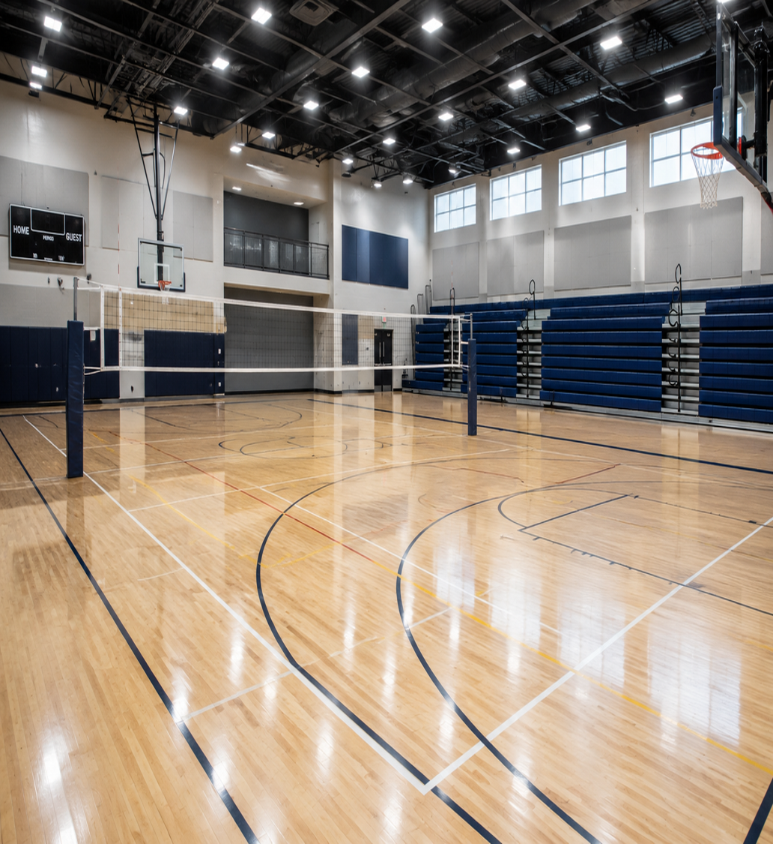

CoViS Module 2
Preventing Violence in Sport
Building respectful, equitable and safer sporting environments
Notes:
Open with the simple message: this module is about recognising concern early, not proving guilt.

Slide 2
Primary prevention starts before harm occurs
The question is not only “what is prohibited?” but “what conditions make GBV less likely?”
Notice
Replace
Reinforce
norms that make disrespect feel normal
sexism and control with equality and autonomy
respectful routines until they become expected
1
2
3
Core message: prevention is the active design of safer norms, relationships and environments.
1. Understanding prevention
Notes:
Explain that primary prevention is proactive. It includes challenging harmful stereotypes, building respectful communication, supporting healthy boundaries, and shaping organisational environments in which dignity and equality are part of everyday sport.

Slide 3
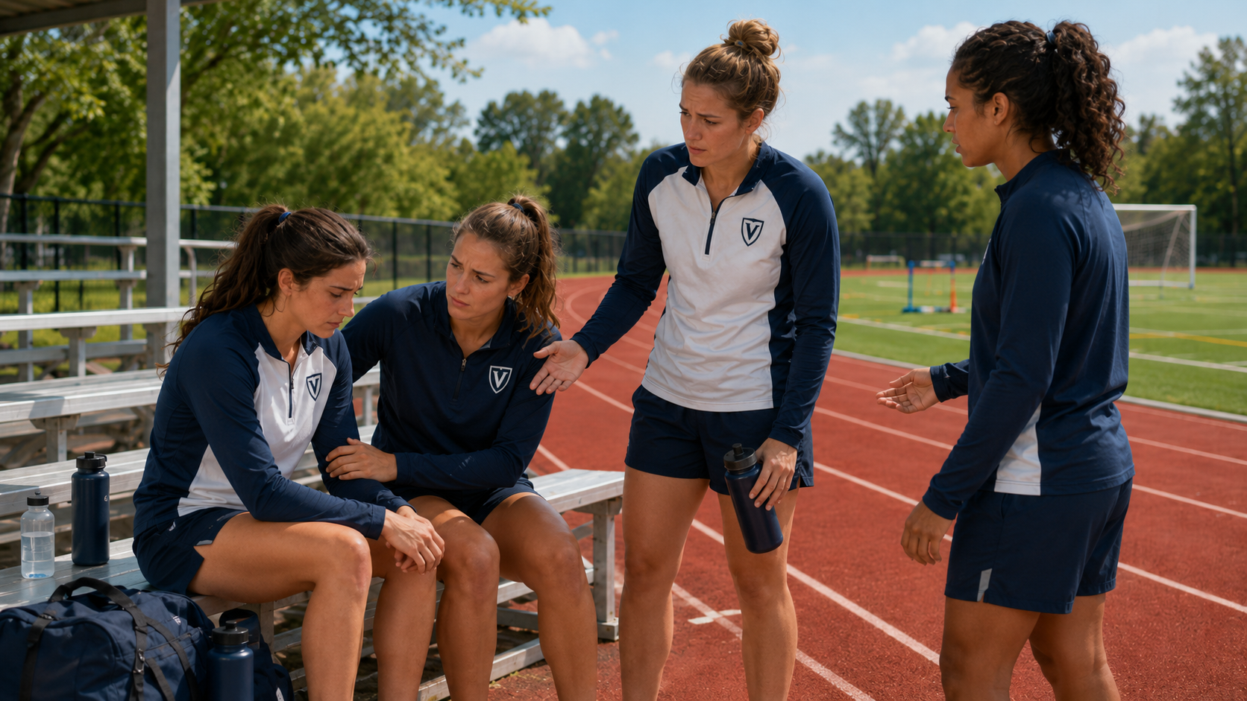
Violence develops in environments - not only in incidents
Sport relationships can be protective when power, trust and boundaries are managed well.
CONDITIONS THAT CAN INCREASE RISK
Sexist stereotypes and sexualisation
Humiliation or degrading “banter”
Unquestioned authority and excessive control
Blurred personal/professional boundaries
Inequality treated as normal team culture
Shift the focus: from “who is the problem?” to “what conditions allow problems to grow?”
Notes:
Use this slide to introduce a social and organisational lens. Harmful behaviour is more likely where disrespect, sexualisation, excessive control or unequal power are normalised. Prevention therefore means changing environments and routines, not only blaming individuals after harm occurs.

Slide 4
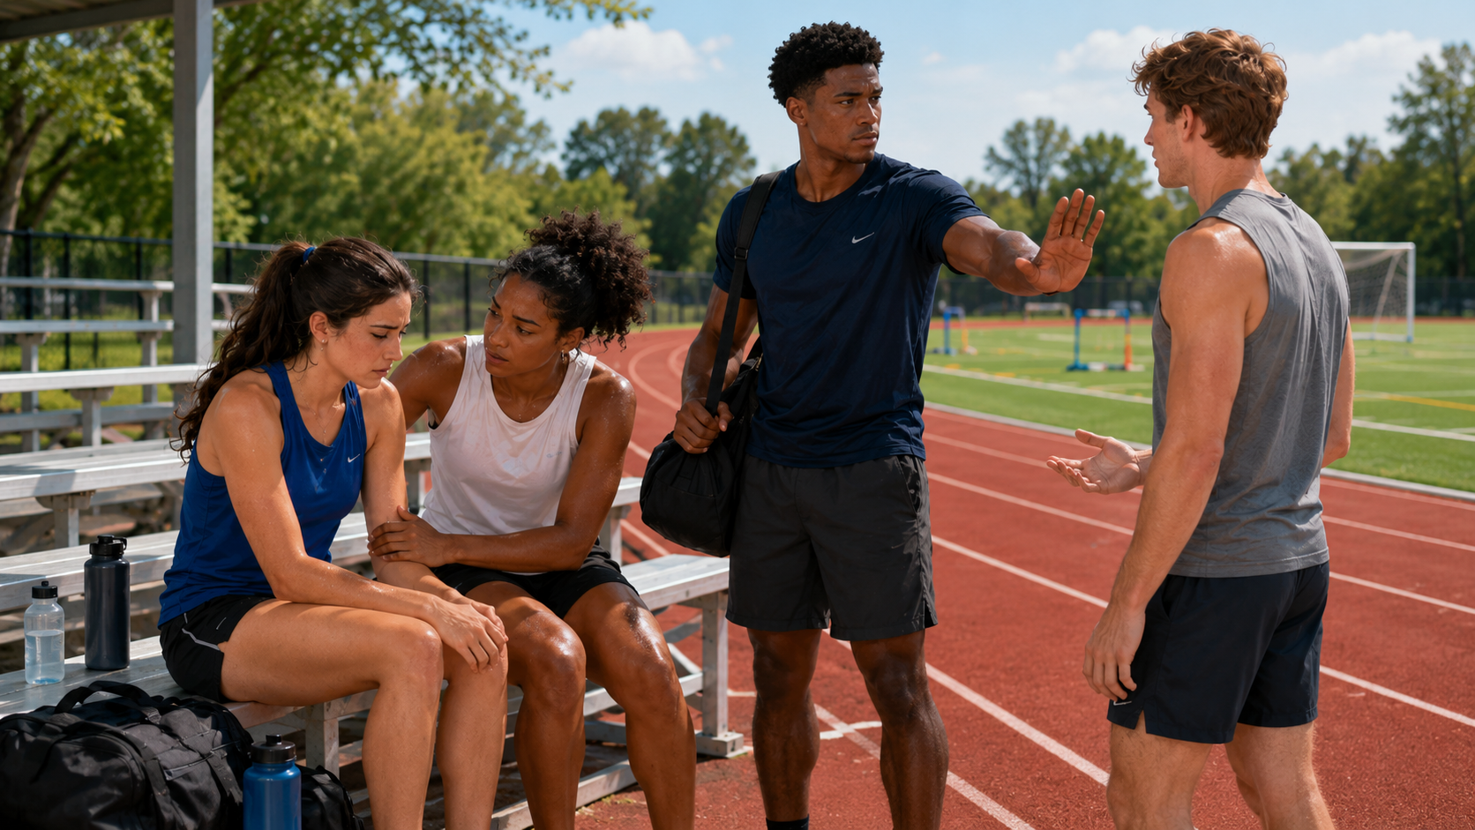
Protective relationships have visible ingredients
Trainees should learn what good practice looks like.
Respect
speak and act with dignity
Equality
no role, gender or status justifies disrespect
Autonomy
athletes can express preferences and limits
Trust
decisions and interactions are transparent
Boundaries
roles stay clear and safe
Performance never justifies humiliation, intimidation or excessive control.
2. Healthy and respectful relationships
Notes:
The aim is to give participants a positive model. Ask: What would an athlete see, hear and experience in a relationship based on these ingredients? Encourage practical examples from coaching, treatment, training and peer interactions.

Slide 5
Use power responsibly
Authority in sport should support athlete autonomy—not increase personal control.
Explain
Invite
Avoid
Check
decisions that affect athletes
questions and preferences
secrecy, favouritism and personal leverage
whether athletes can set limits safely
Practical rule: Is this interaction necessary, transparent, respectful and proportionate?
Use this rule for coaching decisions, physical contact, digital messages, travel and one-to-one sessions.
2. Healthy and respectful relationships
Notes:
Use cases: selection, playing time, access to treatment, travel, scholarships or personal attention. Ask whether the person in authority is using power in a way that supports autonomy and fairness, or in a way that creates dependency or pressure.

Slide 6
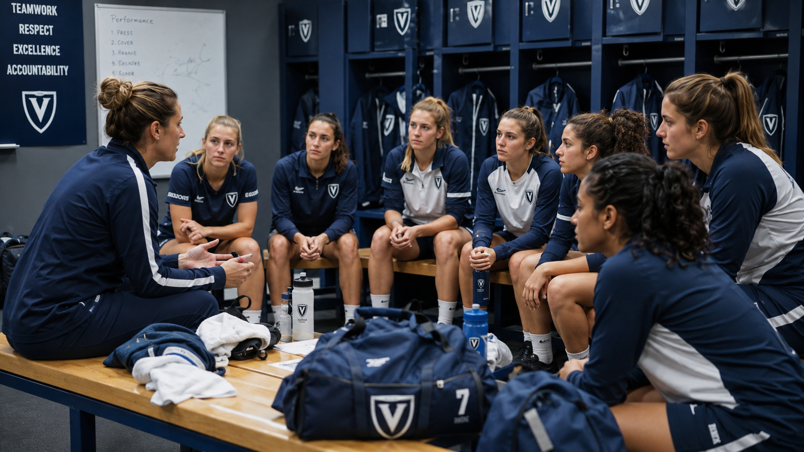
Language shapes what a team accepts
Everyday comments can normalise respect—or normalise disrespect.
Avoid sexist jokes and gender-based insults
Avoid sexualised comments about bodies or appearance
Do not use gender, sexuality or identity to humiliate
Keep feedback focused on performance, technique, health and development
Use inclusive language and correct without attacking dignity
Ask before speaking: Is it necessary? relevant? respectful?
3. Respectful communication
Notes:
Invite participants to identify common phrases in sport that may be normalised but reinforce gender stereotypes or humiliation. Emphasise that the goal is not silence; it is communication that supports dignity, equality and performance development.

Slide 7
Intention is not enough: consider impact
A comment can be meant as a joke and still reinforce harmful norms.
INTENTION
IMPACT
What I meant
What the team learns is acceptable
Shared standards protect the team: no sexualised nicknames, no degrading images, no gender or sexuality as insults, no private messages that blur roles.
“Which expressions in sport are often excused as banter?”
Notes:
Ask the group to think of phrases or messages that might be intended as humour or motivation, but could contribute to disrespectful norms. Then invite safer alternatives. Emphasise digital communication: group chats and private messages should follow the same standards as face-to-face communication.

Slide 8
Peer culture can protect - or create risk
Teams should make expectations explicit rather than relying on assumptions.
RISK-PROMOTING NORMS
PROTECTIVE NORMS
Sexual pressure
Hazing or initiation rituals
Degrading body comments
Homophobic or sexist teasing
Sharing intimate material
Respect personal space
Protect changing-room privacy
Reject sexualised “team culture”
Value equality and inclusion
Model positive standards
The goal: every athlete can belong without pressure, humiliation or sexualisation.
4. Peers and teammates
Notes:
Use examples from the sport context: changing rooms, team travel, celebrations, group chats and initiation rituals. Emphasise that new athletes often learn team culture from senior athletes and captains, so positive role modelling matters.

Slide 9
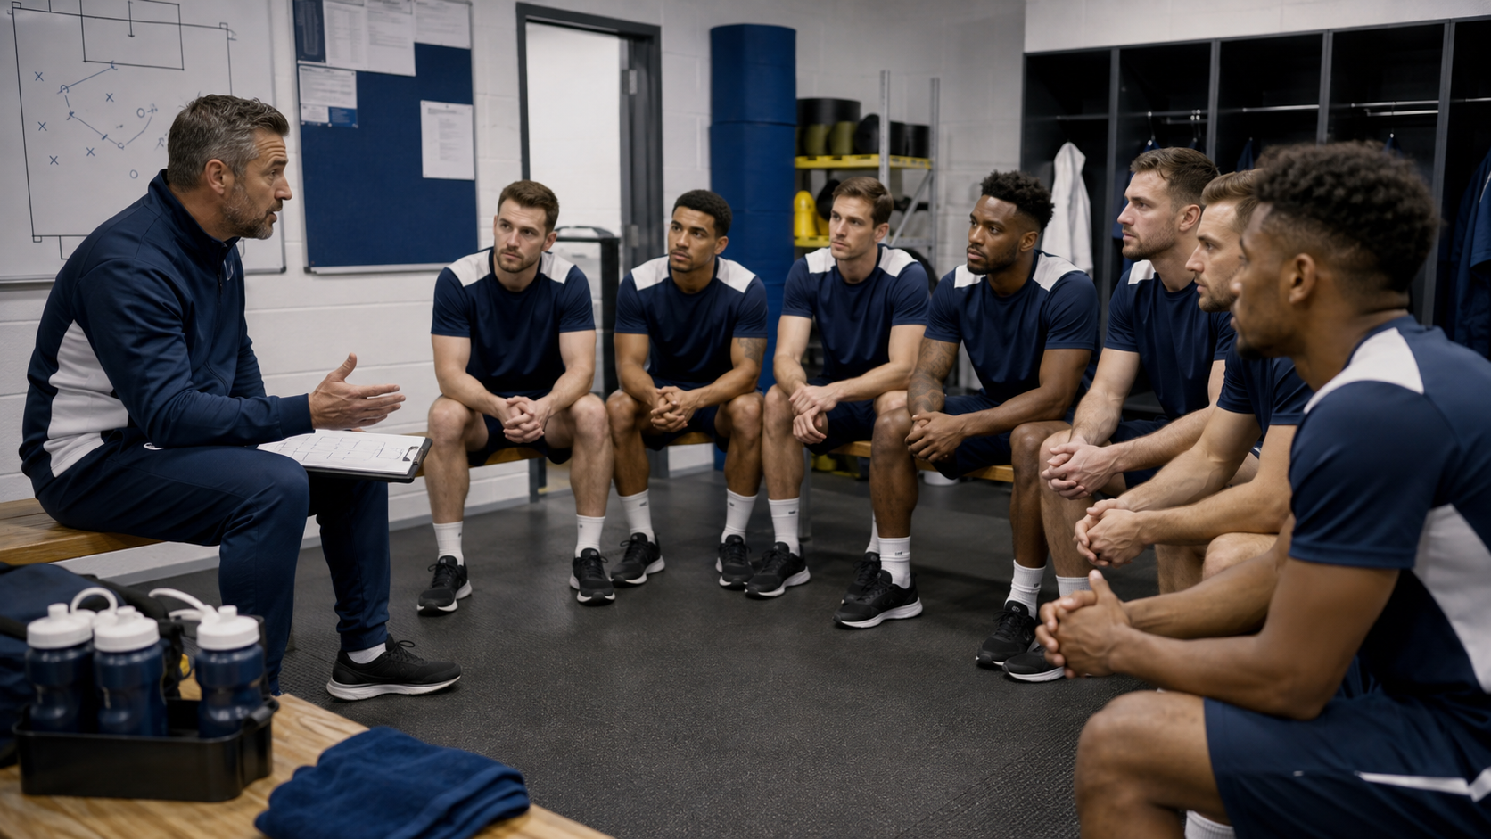
Make peer expectations concrete
A Team Respect Agreement turns values into visible norms.
Team Respect Agreement
How we communicate online and offline
How we protect privacy and changing-room dignity
How we avoid sexist or sexualised practices
How senior athletes model standards for new members
When we revisit expectations: travel, tournaments, celebrations
Mini-task: add one standard your team needs most.
4. Peers and teammates
Notes:
This slide can introduce a short group task. Ask participants to write two or three concrete team standards. Keep them positive and practical. For example: We do not use gender or sexuality to humiliate others; We do not share images without permission; We communicate respectfully in team chats.

Slide 10
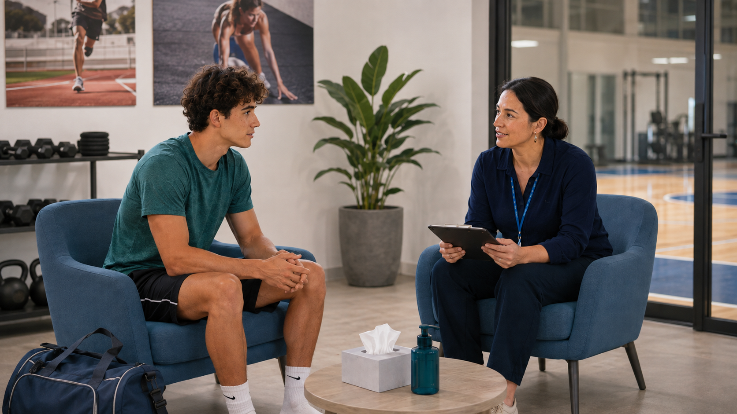
ASP can create protection through professionalism
Expertise, authority and trust must be managed carefully.
Keep interactions necessary for the professional role
Be transparent, respectful and proportionate
Avoid sexualised comments or intrusive private questions
Avoid unnecessary secrecy, favouritism and dependency
Use authority to support athlete autonomy
Professional boundaries protect athletes and ASP.
Notes:
Define ASP broadly: coaches, doctors, physiotherapists, psychologists, nutritionists, strength and conditioning staff, team managers and other professionals. The key principle is that closeness and trust are not problems when professional boundaries are clear and power is managed responsibly.

Slide 11
Boundary practices for common sport situations
Prevent ambiguity before it becomes risky.
Physical contact
Clear professional purpose; explain what will happen and why
One-to-one sessions
Protect confidentiality without unnecessary isolation
Digital communication
Appropriate channel, content, timing and frequency
Travel and accommodation
Preserve privacy and professional roles
Selection/treatment
Use clear criteria, not personal closeness
Reflection: Which of these situations is most ambiguous in your sport?
Notes:
Use this as a practical discussion slide. Ask participants to identify where boundaries might become unclear in their setting. Then ask how the situation could be organised differently without reducing effective coaching or support.

Slide 12
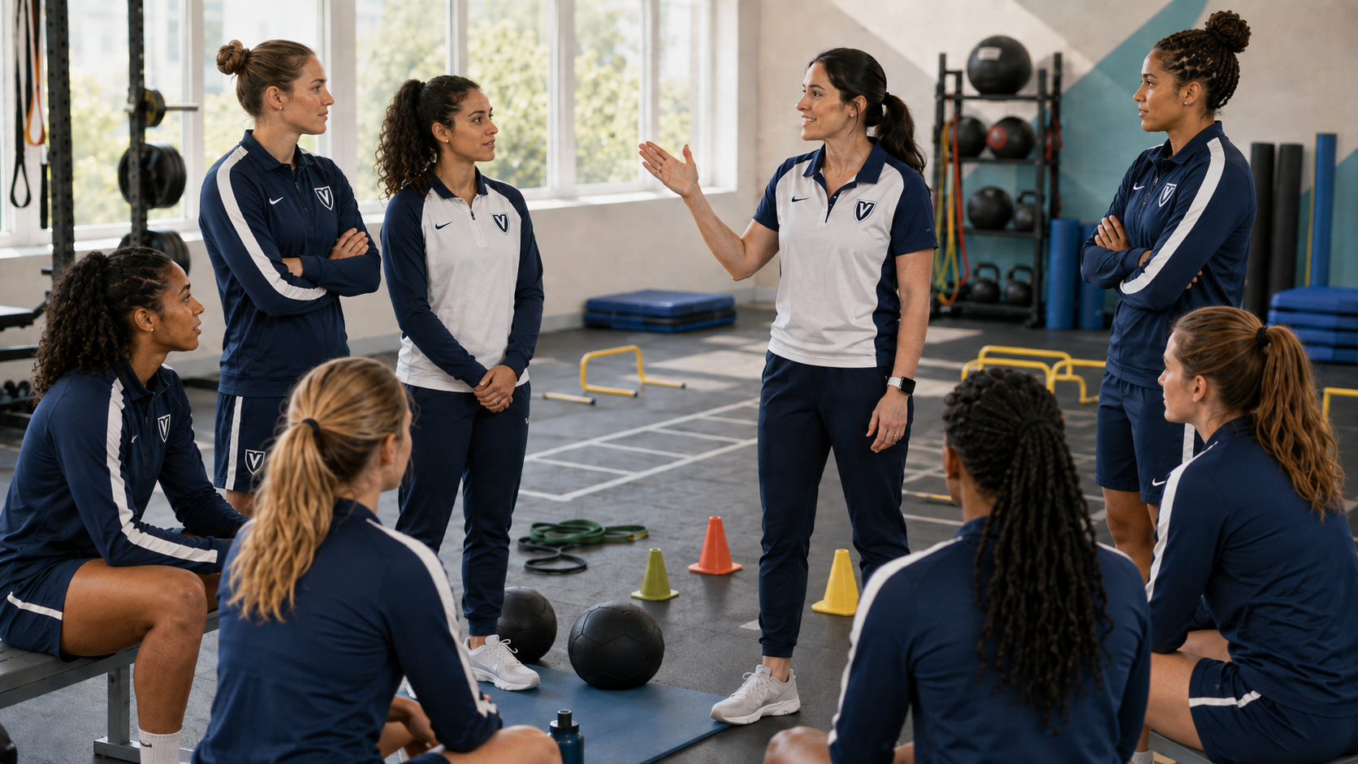
Organisations must design prevention into the system
Prevention cannot depend only on individuals behaving well.
Define acceptable conduct in practical terms
Communicate expectations during induction
Revisit standards regularly—not once
Apply expectations consistently to athletes, coaches, ASP, volunteers and managers
Review whether organisational routines make respectful behaviour easier
System question: Does our organisation make safe behaviour the expected option?
Notes:
Emphasise organisational responsibility. Even motivated individuals work inside routines, spaces, policies and informal cultures. Organisations can reduce risk by clarifying expectations and redesigning contexts where power imbalance, privacy or lack of oversight may increase ambiguity.

Slide 13
Redesign higher-risk situations
The objective is not to eliminate privacy, but to protect dignity and boundaries.
One-to-one meetings
Treatment rooms
appropriate and transparent spaces
confidentiality without unnecessary isolation
Changing areas
Travel
clear access and privacy rules
accommodation that preserves roles and privacy
Photos and filming
Private messaging
permission, purpose and safe storage
clear rules for content, timing and channels
Choose one situation and redesign it with respect, autonomy and boundaries in mind.
Notes:
Use this slide for applied thinking. Ask participants to choose the situation most relevant to their sport and propose specific safeguards. The aim is to plan necessary interactions in ways that protect privacy, autonomy and professional boundaries.

Slide 14
Build what you want to see
A positive prevention culture actively promotes protective norms.
RESPECT
EQUALITY
AUTONOMY
BOUNDARIES
SAFETY
dignity in daily interactions
fair treatment and opportunity
voice, choice and personal limits
clear roles and safe practices
wellbeing over performance at any cost
A team’s identity is shaped by what it repeats, rewards and models.
7. Positive prevention culture
Notes:
Move beyond a list of prohibitions. Ask participants: What should an athlete actually experience in a safe and respectful sport environment? Emphasise that prevention culture is created through repeated everyday practices.

Slide 15
Funded by the European Union. Views and opinions expressed are however those of the author(s) only and do not necessarily reflect those of the European Union or the European Education and Culture Executive Agency (EACEA). Neither the European Union nor EACEA can be held responsible for them.

