Slide 1



CoViS Module 1
Recognising
Violence
in Sport
Understanding sexual harassment, boundary violations, grooming and abuse of power
Notes:
Open with the simple message: this module is about recognising concern early, not proving guilt.

Slide 2


Why recognition matters
Recognition starts before proof.
Sport relies on trust, teamwork, travel, physical instruction and close cooperation.
These same features can make inappropriate behaviour harder to identify.
›
Notice what was seen, heard, received or disclosed.
›
Ask why the behaviour feels unsafe or inappropriate.
›
Do not investigate or decide guilt yourself.
›
Make sure the concern is not ignored.
Harassment often develops gradually, not as one obvious event.
Notes:
Emphasise the distinction between recognition and investigation.

Slide 3
What the CoViS evidence shows
Sample findings are not national prevalence estimates, but they show clear educational needs.
50.0%
reported exposure to at least one form of sexualised behaviour
48.9%
received comments about body, clothing, marital status or sexuality
44.0%
reported sex- or gender-based insults or mocking comments
22.3%
reported unwanted or inappropriate physical touching
14.7%
reported sexual remarks, aggressive calls or unwanted photos
12.0%
reported sexual blackmail or coercion into sexual contact
The key teaching point: everyday comments, mockery and boundary testing
may be the first visible signs of a pattern.
CoViS Needs Analysis, 2026 — sample findings.

Slide 4
What harassment can look like
VERBAL
PHYSICAL
“Nice body. Are you seeing anyone?”
Repeated after discomfort.
The athlete steps back, but the person moves closer and touches them again.
NON-VERBAL
DIGITAL
Repeated staring, sexual gestures, showing images or taking photos without permission.
“Send me a photo. Use disappearing messages — no one else needs to know.”
The meaning depends on context, repetition, secrecy, power imbalance and the athlete’s ability to refuse.
CoViS Module 1: illustrative examples for recognition training.

Slide 5
Boundaries, grooming and power
Three concepts that help explain why athletes may not feel free to refuse.
Boundary
violation
Grooming
Abuse
of power
A gradual process: access and trust → special treatment → isolation → secrecy → boundary testing → escalation.
Behaviour that crosses role-appropriate limits and creates risk, confusion or dependency.
Power may come from selection, travel, contracts, medical care, training conditions or career progression.
Example: repeated private messages without a clear sporting purpose.
Concern rises when behaviours form a repeated pattern.
The key question: was the athlete free to say no?
IOC Consensus Statement 2024; IOC Safeguarding Toolkit; CoViS Needs Analysis.

Slide 6
Why it can be difficult to recognise
Sport culture may normalise behaviour that should be questioned.
Mockery is not harmless
just because it is called “banter”.
It becomes a safeguarding concern when it…
›
humiliates or targets identity
Examples: “You throw like a girl.”
“This is a man’s sport.”
“Stop being so emotional.”
“Relax, it was only a joke.”
›
is repeated or escalating
›
uses power imbalance
›
continues after discomfort is shown
44.0%
reported sex- or gender-based insults or mocking comments
CoViS Needs Analysis, 2026; CoViS Module 1 explanation of mockery.

Slide 7

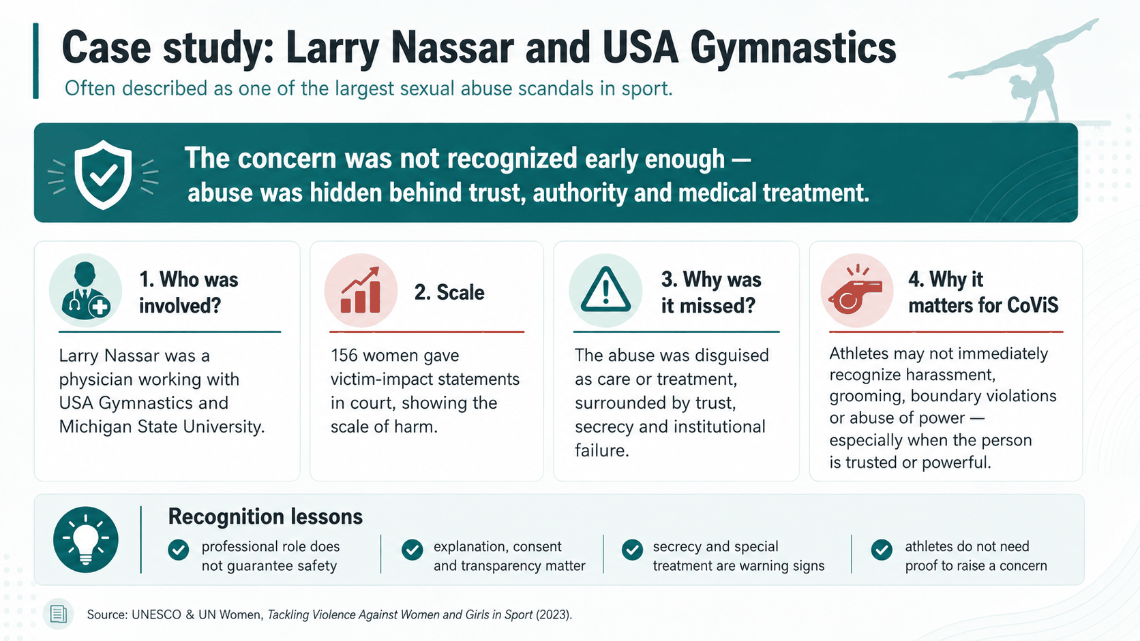

Slide 8
CoViS Traffic-Light Guide
A recognition aid — not a legal, diagnostic or investigative classification.
GREEN
Appropriate, professional and transparent.
Clear purpose. Permission. Transparency. Boundaries respected.
AMBER
Boundary concern.
Secrecy. Favouritism. Private channels. Escalation. Dismissed discomfort.
RED
Unacceptable or prohibited behaviour.
Coercion. Threats. Sexualised conduct. Retaliation. Continuing after refusal.
Amber does not establish guilt. It means the situation deserves attention and should not be dismissed.
CoViS educational framework based on CoViS Needs Analysis and international safeguarding principles.

Slide 9
Situations that require stronger safeguards
High-risk does not mean proof — it means transparency and supervision matter more.
Travel & accommodation
One-to-one training
Rooming, alcohol, transport and supervision rules need to be clear.
Use observable settings and agreed hours.
Medical care / physiotherapy
Locker rooms
Explain purpose, seek permission, protect privacy.
Clear rules on adult access, phones and photography.
Private transport
Digital communication
Avoid unnecessary repeated private transport.
Keep communication official, transparent and role-related.
The concern is the behaviour, not the professional title. Safeguarding applies to coaches, doctors, physiotherapists, officials, volunteers, teammates and others.
IOC Safeguarding Toolkit; CoViS Module 1 high-risk situations.

Slide 10
CoViS five-question recognition check
A practical tool for unclear situations.
WANTED?
NECESSARY?
Is the athlete comfortable with it?
Is there a clear sport, medical, educational or safety reason?
TRANSPARENT?
FREE TO SAY NO?
Would this happen the same way if others were present?
Could refusing affect selection, support or opportunity?
SECRET OR ESCALATING?
Is it becoming more private, personal or intense?
If one or more answers raise concern, do not ignore it. You do not need proof to seek advice or communicate a safeguarding concern.
CoViS Module 1: Five-question recognition check.

Slide 11

First response and further resources
Recognise early. Listen carefully. Use the safeguarding channel.
First response
›
Take the concern seriously.
›
Prioritise immediate safety.
›
Listen without blaming.
›
Do not investigate or confront alone.
›
Use the designated safeguarding channel.
References & practical resources
CoViS Needs Analysis, 2026 • IOC Consensus Statement, 2024 • IOC Consensus Statement, 2016 • IOC Safeguarding Toolkit for IFs and NOCs • IOC Athlete365 Safe Sport • U.S. Center for SafeSport resources • UNESCO Tackling Violence Against Women and Girls in Sport

Slide 12
Funded by the European Union. Views and opinions expressed are however those of the author(s) only and do not necessarily reflect those of the European Union or the European Education and Culture Executive Agency (EACEA). Neither the European Union nor EACEA can be held responsible for them.

